Slide 1
REACT CLUSTER WEBINAR 5
CLARUS MLOps: Automating data and AI model sharing in the European food industry

Slide 2
Contents
1
Intro to CLARUS use cases and AI Toolkit
2
MLops needs: principles & stages
3
CLARUS MLops: the solution

Slide 3
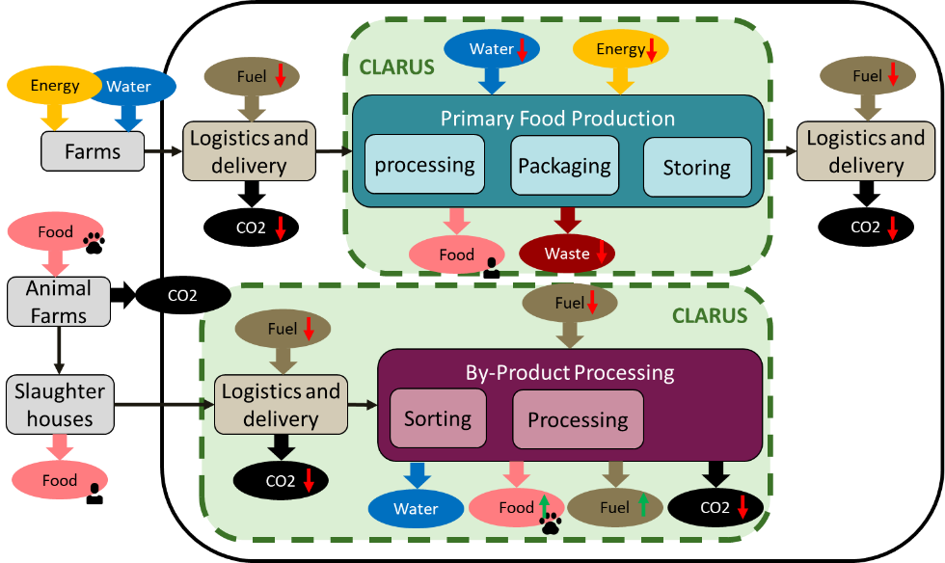
1. Intro to CLARUS AI Toolkit
Validation
Two pilots for validating the CLARUS solution:
Production of the frozen food, where energy and water consumption can be reduced using AI and data technologies.
Meat by-product production where the aim is to reduce the energy and maintain the quality of the products by optimizing the logistics of the by-products arrival.

Slide 4
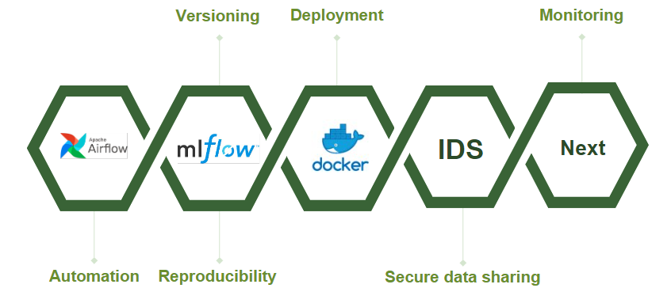
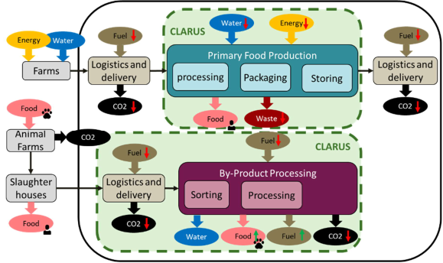
1. Intro to CLARUS AI Toolkit
TEO 3: The AI toolkit encompasses both the MLOps workflow/platform and the AI models themselves
CLARUS MLOps platform services
Data & models transport
TEO2:
Clarus DataSpace
CLARUS AI requirements (T4.1)
Supports lifecycle of
TEO1:
CLARUS GDI
Primary food processing AI models design
Op. vars <-> GDI KPI-s
By-product processing AI models design

Slide 5
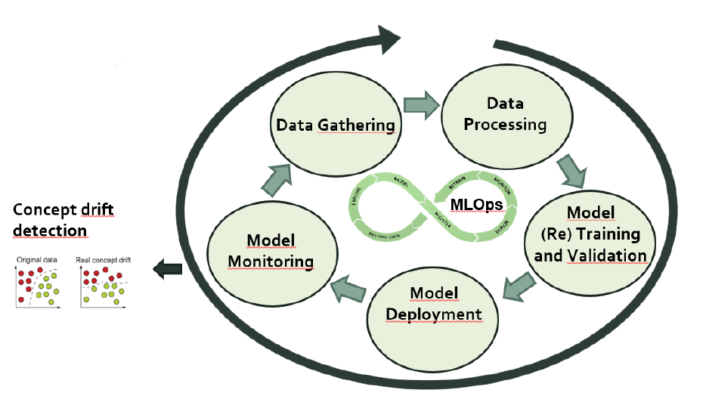
2. MLOps needs: principles & stages
MLOps (Machine Learning Operations) is a set of practices and principles aimed at streamlining the deployment, management, and maintenance of machine learning (ML) models in production environments.
Automation:
In ML, it automates
repetitive processes like data preprocessing and model deployment, improving efficiency.
Versioning:
assigns unique identifiers to changes in software or data, enabling
developers to track modifications.
Monitorization: Monitoring continuously observes software or ML models in production to detect issues or changes in real-world data.
Reproducibility: ensures the ability to recreate ML experiments or model outcomes
by documenting code, data, and settings.

Slide 6
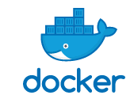


3. CLARUS MLOps solution: toolkit
Versioning
Deployment
Monitoring
IDS
Evidently
Automation
Reproducibility
Secure data sharing

Slide 7
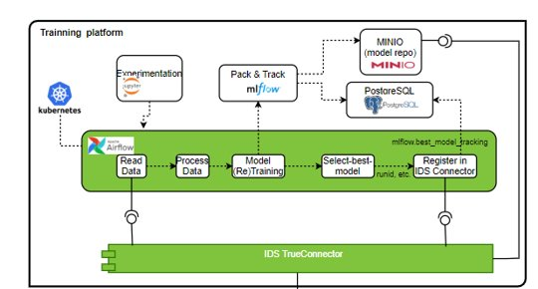
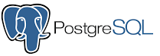


3. CLARUS MLOps solution: toolkit
REPRODUCIBILITY
Relational database management system.
Web application that allows users to create and share
documents containing live code, equations, visualizations.
Platform for
orchestrating complex workflows and data pipelines.
Platform for managing the end-to-end machine learning lifecycle.
Object storage server compatible with Amazon S3.
REPRODUCIBILITY
AUTOMATION
VERSIONING

Slide 8
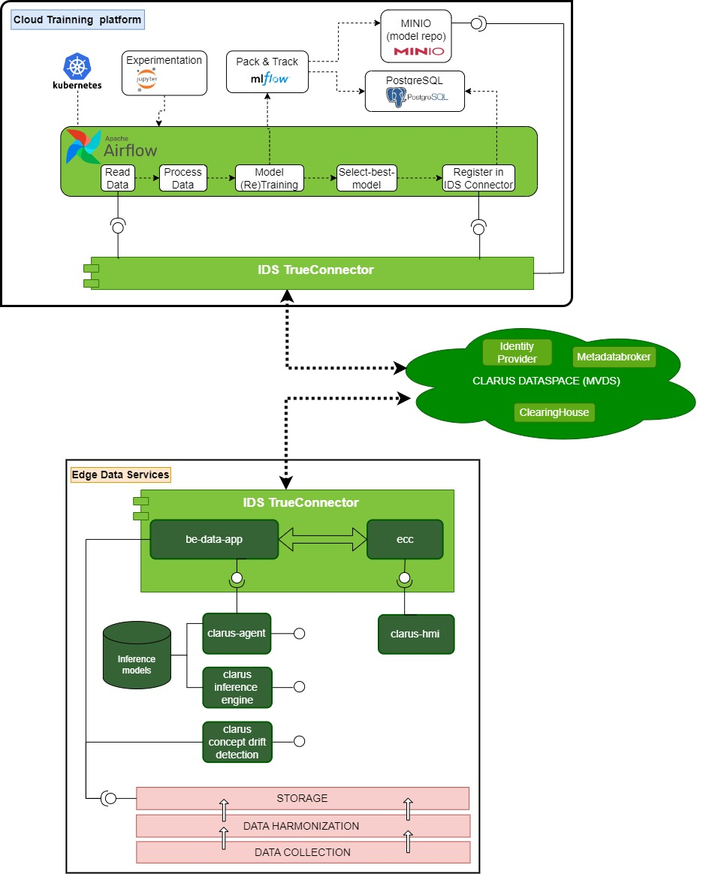
3. CLARUS MLOps solution: edge to cloud architecture
MLOps strategy for the edge to cloud lifecycle management of the CLARUS AI algorithms
Reading data from the pilot´s edge (through IDS)
Processing data
Training and validation
Best model selection
Model registration in the cloud IDS connector, thus making it ready to download to the Edge.
Data collection (Edge exposes data through IDS)
Model inference
Concept drift detection

Slide 9
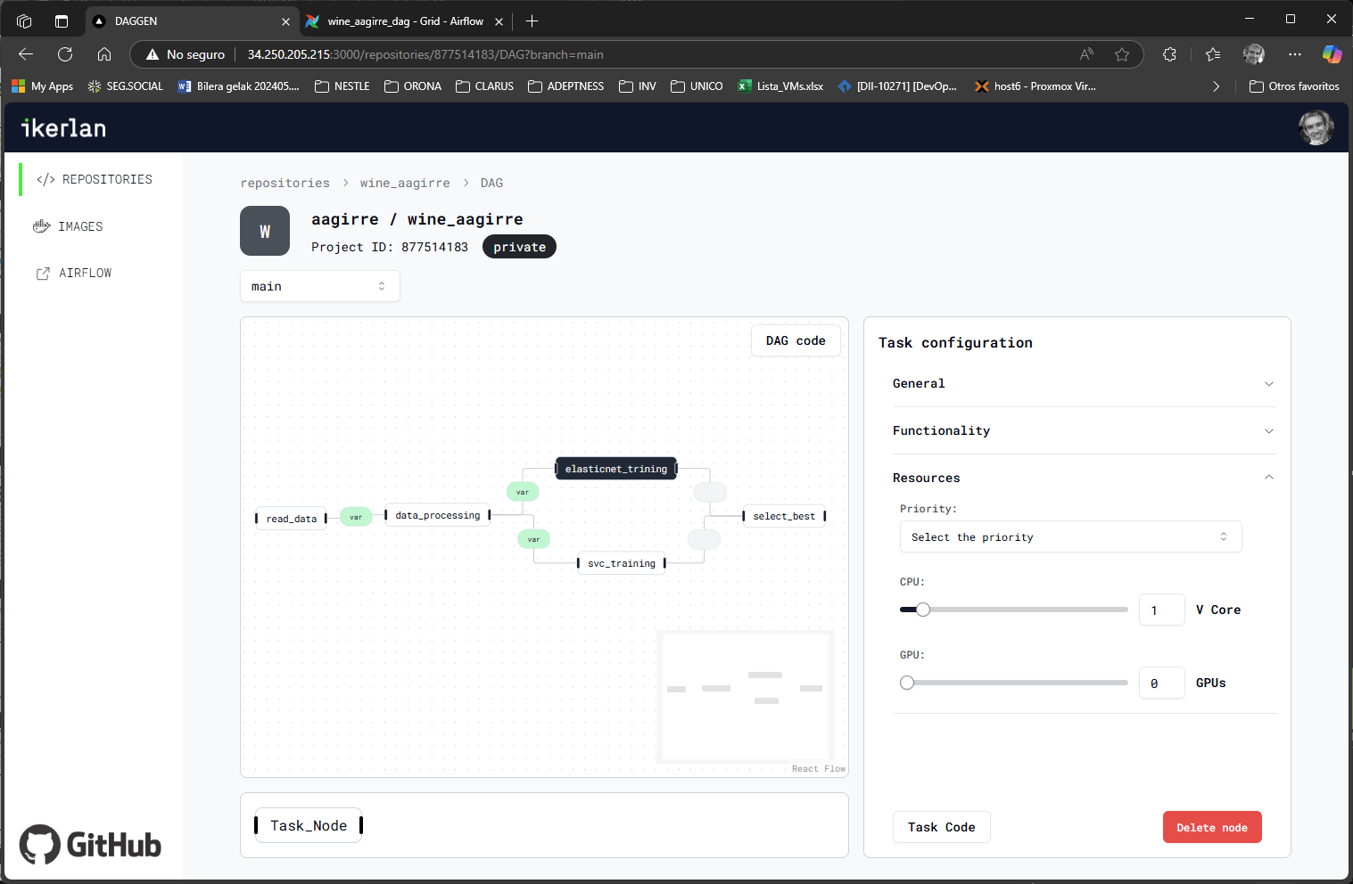
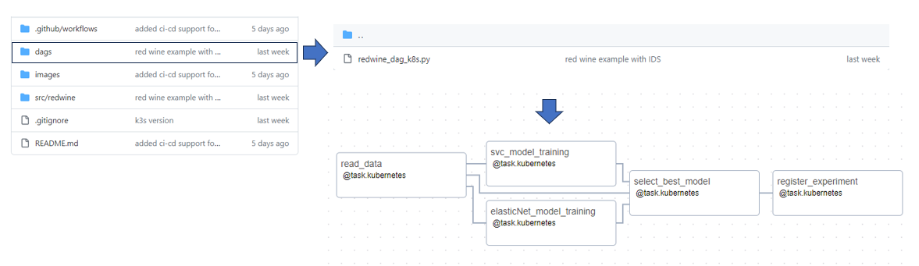
3. CLARUS MLOps solution: DAG generation
For orchestrating workflows
Graphical tool to generate the DAG
For orchestrating workflows

Slide 10
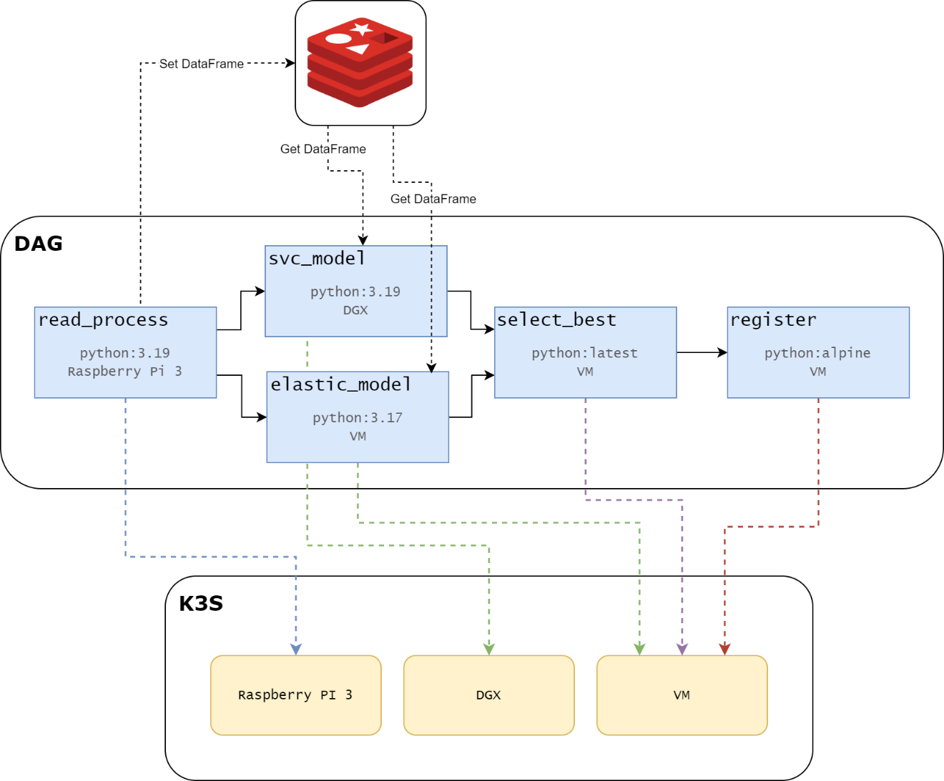
3. CLARUS MLOps solution: Implementation over K3S
Airflow, Mlflow, PostgreSQL, MinIO, Redis over Kubernetes
In the DAG implementation, you can define all the aspects of the execution, such as selecting the appropriate docker image or hardware node.
Allows the execution of each of the tasks in a specific container, reducing conflicts between tasks that might require different versions of the same library.
Allows parallelization across multiple nodes

Slide 11
3. CLARUS MLOps solution: current features summary
Design and development of an open source MLOps strategy / tool suite for the lifecycle management of the AI models, including continuous training, validation, tracking, deployment and monitoring.
                Seamless on-premise installation
                Graphical tool support for ML models DAGs
                Edge2Cloud deployment capabilities over IDS
                Parallel training over K3s on premise clusters/GPUs
                Integration with user hosted private GIT repos
                High level of customization of the DAG tasks
                RBAC
                Concept drift monitoring service

Slide 12
Thank You
Do you have any questions?
CLARUS MLOps: Automating data and AI model sharing in the European food industry

