Slide 1
Project Presentation
Gabriella Monteleone
CLARUS Project Coordinator

Slide 2
CLARUS
“Optimizing Production and Logistic Resources
in the Time-critical
Bio Production Industries
in Europe”
Grant agreement ID: 101070076
Start date: 1 September 2022
End date: 31 August 2025
Total cost: € 3 423 248,75
EU contribution: € 2 999 105,75

Slide 3
Consortium

Slide 4
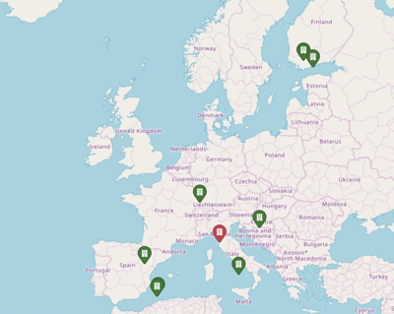
Partners Information
 | Short Name | Legal Name | Role | Type | Country
1 | POLIMI | POLITECNICO DI MILANO | COO | University | IT
2 | TAU | TAMPEREEN KORKEAKOULUSAATIO SR | BEN | University | FI
3 | UPV | UNIVERSITAT POLITECNICA DE VALENCIA | BEN | University | ES
4 | ENG | ENGINEERING - INGEGNERIA INFORMATICA SPA | BEN | Large Enterprise | IT
5 | IKERLAN | IKERLAN S. COOP | BEN | Research centre | ES
6 | KNOW | KNOW-CENTER GMBH RESEARCH CENTER FOR DATA-DRIVEN BUSINESS & BIG DATA ANALYTICS | BEN | Research centre | AT
7 | EAI | EXPERTAI LUX S.A.R.L | BEN | SME | LU
8 | HONKA | HONKAJOKI OY | BEN | Industry | FI
8.1 | GMM | GMM FINLAND OY | AE | Industry | FI
9 | ARDO | ARDO BENIMODO SL | BEN | Industry | ES

Slide 5
CLARUS vision, mission, objectives
Gabriella Monteleone

Slide 6
Context
The growth of the world’s human population, the advent of resource shortages and environmental difficulties are forcing industrial sectors to face sustainability issues more than ever.
Due to its high consumption of natural resources, food industry represents one of the main sectors requiring a long-term vision to manage sustainability.
There is the need to guide the sector toward a Green Transition by improving the environmental and social sustainability of its activities, products and processes, leveraging also on Digital Transition.

Slide 7
Objectives
The CLARUS project aims to connect the Sustainable Paradigm in the food industry and AI-based applications, with the goal of developing a platform with high communications and processing capabilities, as well as the use of standardized open protocols and data models that will allow resource consumption assessment and traceability for food industry processes.
The project was submitted under the call HE-CL4-DIGITAL-EMERGING-01-09: AI, Data and Robotics for the Green Deal and targets the non-robotic outcome.

Slide 8
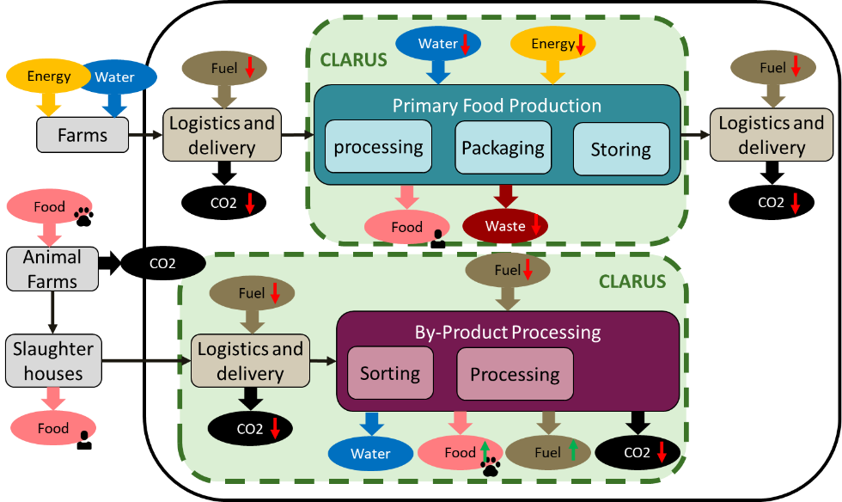
Validation
Two pilots for validating the CLARUS solution:
Production of the frozen food, where energy and water consumption can be reduced using AI and data technologies.
Meat by-product production where the aim is to reduce the energy and maintain the quality of the products by optimizing the logistics of the by-products arrival.

Slide 9
Benefits
Correct collection, analysis and tracing of “Sustainability Data” of food production and consumption, can lead to enormous benefits for the natural resources management within food manufacturing systems and food supply chains.
Digital Transformation of food companies represents an enabler of Sustainability Transformation thanks to the benefits smart technologies can offer in terms of data management and elaboration.

Slide 10
Ambition
CLARUS is strictly connected with the European Green Deal program in order to develop and define a unique quantitative and standard methodology to support the elaboration of a green-friendly food industry structure and culture, that can generate business in a sustainable way and with a much smaller impact on the environment.
CLARUS ambitions try not only to contribute to resource and logistic optimization methods with the two pilots' solutions but aims to generate a more general contribution with the creation of a Green Deal Index (GDI).

Slide 11
Impact on the green deal concept
CLARUS Green Deal Index: methods, tools and data used to calculate the Green Deal Index (GDI). This GDI would be applied to different dimensional scales (e.g., companies, cities, countries, or processes) allowing to have a complete measure of how compliant with the Green Deal they are.
CLARUS Data Space: FAIR data models and Industrial Data Platforms tools that are developed and deployed for edge data management, cloud data management, and data harmonization, transformation and sharing.
CLARUS AI Toolkit: AI algorithms and the trained models that are developed, tested, and validated in the project.

Slide 12
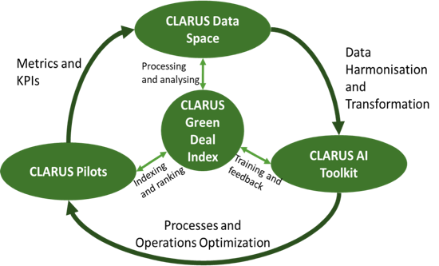
Approach
The CLARUS Green Deal Index processes and analyses the data in the CLARUS Data SPACE.
The processing and analysis is done by the CLARUS AI Toolkit.
The CLARUS GDI interacts with the CLARUS Pilots to provide the indexing and ranking feature to drive the improvements towards Green Deal friendlier process and operations.

Slide 13
Strategy
CLARUS Strategy is to utilize the synergy of innovative AI techniques with the available data from the production process to optimize resource consumption during the production, providing optimization of the recycling process after the production, alongside ensuring high product quality and process efficiency.
Data integration to improve reconfiguration, scalability and optimization of resources and processes.
Interoperable mechanisms to enable the introduction of methods for evaluation of resource distribution and waste.

Slide 14
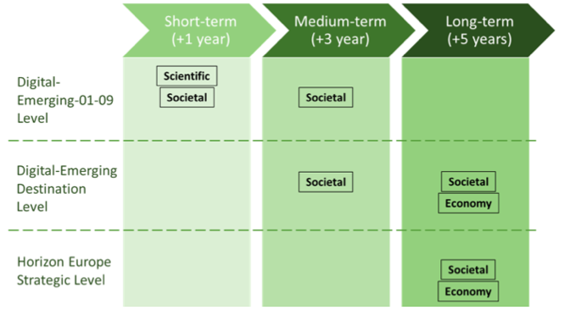
Impacts
Scientific: new knowledge and experience in assessing the impact on the Green Deal plan.
Societal: clear metric on the impact of organization that present the friendliness with respect to the Green Deal Plan which will improve overall wellbeing.
Economy: proper ranking and indexing of companies, factories, cities, and countries reducing the needed effort to determine the problem and help in reaching faster and more accurate results in improving the impact on the Green Deal.

Slide 15
Methodology, implementation structure and plan
Gabriella Monteleone

Slide 16
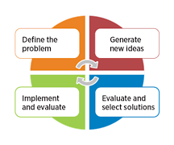
Problem Solving Approach
Use-cases driven
Demonstrate technology performance and added value to the application field
Deep involvement of stakeholders

Slide 17
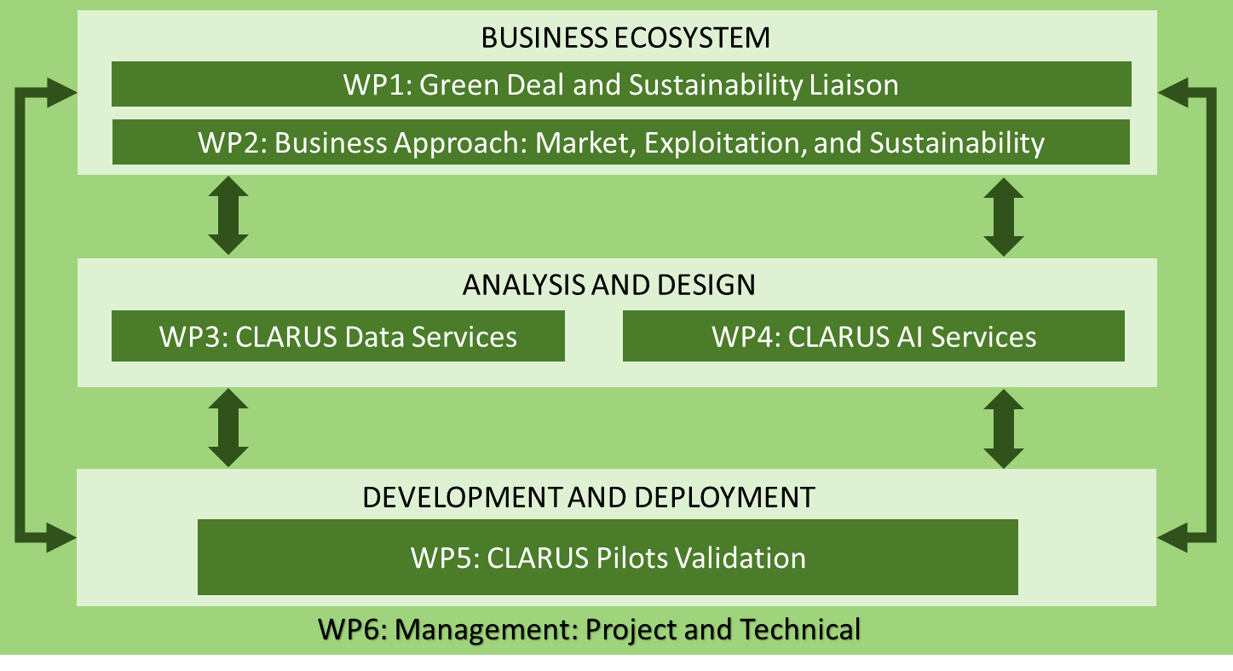
Implementation Structure and Resources
 | Work package Title | Leader short name | Effort [PM] | Start | End
WP1 | Green deal and Sustainability Liaison | POLIMI | 51 | 1 | 36
WP2 | Business Ecosystem and CLARUS Dissemination and Exploitation | KNOW | 88 | 1 | 36
WP3 | CLARUS Data Services | ENG | 86 | 1 | 30
WP4 | CLARUS AI Services | IKERLAN | 86 | 1 | 30
WP5 | CLARUS Pilots Validation | TAU | 117 | 9 | 36
WP6 | Project Coordination and Consortium Management | POLIMI | 38 | 1 | 36
Total |  |  | 466

Slide 18
Project implementation timeline

Slide 19
Milestones
No. | Milestone title | Work package | Due date | Means of verification
Mi1 Initiated | Requirements, Project and Data Management guidelines | WP1, WP6 | M06 | Release of the project handbook, (D6.1). Initial specifications of the Data Management Plan (D6.3). Pilot requirements collection and its Analysis (D1.1). Project Website.
Mi2 Prepared | Green Deal Sustainability Guidelines | WP1, WP2, WP3, WP4, WP6 | M12 | Development of Green Deal KPIs (D1.2). Data Models Definition (D3.1, D6.2). Machine Learning Lifecycle (D4.1). Exploitation Strategy and Plans: Individual and Joint (D2.1, D2.2).
Mi3 Developed | Development of AI and Data Services | WP3, WP4, WP5, WP6 | M18 | Technical Infrastructure Establishment. Data and AI Platform Building (D3.2, D3.3, D4.1, D4.2, D4.3, D5.1). Process Quality Assurance (D6.2)
Mi4 Refined | Edge-Cloud Platform Integration | WP2, WP5, WP6 | M24 | Edge-Cloud Platform Integration (D5.2). Quality and KPIs Validation (D6.3). Report on Cooperation and Dissemination (D2.2)
Mi5 Established | AI and Data Services Assessment | WP3, WP4, WP6 | M30 | AI and Data Services for Primary Food and By-product Quality Evaluation (D3.2, D3.3, D4.2, D4.3, D6.2)
Mi6 Matured | CLARUS Pilot Validated | WP1, WP2, WP5, WP6 | M36 | Green Deal Sustainability Maturity Assessment (D1.3, D5.2, D5.3). Report on Exploitation, Dissemination and User Training (D2.1, D2.2, 2.3, D6.3)

Slide 20
Deliverables
No. | Deliverable title | WP | Leader | Type | Diss. level | Due date
D1.1 | Use Case Analysis | 1 | TAU | R | SEN | M06
D1.2 | Green Deal KPIs | 1 | POLIMI | R | PU | M08
D1.3 | Sustainability Maturity Assessment | 1 | POLIMI | R | PU | M36
D2.1 | Report on Exploitation and Sustainability Strategy | 2 | KNOW | R | PU | M12, M36
D2.2 | Report on Dissemination and cooperation Activities | 2 | UPV | R | SEN | M12, M24, M36
D2.3 | Report on User Training | 2 | POLIMI | R | PU | M36
D3.1 | CLARUS Data Approach | 3 | ENG | OTHER | PU | M09
D3.2 | Edge-Cloud Data Management Services | 3 | IKERLAN | DEM | SEN | M18-M30
D3.3 | Data Harmonization and Transformation | 3 | TAU | DEM | SEN | M18-M30
D4.1 | Model lifecycle management - MLOps- | 4 | IKERLAN | DEM | SEN | M12, M18
D4.2 | Primary Food Processing AI design | 4 | UPV | DEM | SEN | M18, M30
D4.3 | By-product AI design | 4 | TAU | DEM | SEN | M18, M30
D5.1 | Integration and Data Engineering Report | 5 | TAU | R | PU | M18
D5.2 | Pilot Validation Report | 5 | TAU | DEM | SEN | M24, M36
D5.3 | Green Deal Index Assessment Report | 5 | POLIMI | DEM | SEN | M36
D6.1 | Project Management Handbook | 6 | POLIMI | R | PU | M03
D6.2 | Project progress reporting | 6 | POLIMI | R | SEN | M6, M12, M18, M24, M30, M36
D6.3 | Quality, Risk and Data Management Plan | 6 | EAI | R | SEN | M6, M18, M36

Slide 21
Overall Effort
 | WP1 | WP2 | WP3 | WP4 | WP5 | WP6 | Total
POLIMI | 18 | 16 | 4 | 4 | 14 | 24 | 80
TAU | 6 | 3 | 9 | 9 | 15 | 1 | 43
UPV | 10 | 12 | 8 | 10 | 12 | 1 | 53
ENG | 9 | 12 | 34 | 13 | 19 | 3 | 90
IKERLAN | 1 | 3 | 17 | 30 | 4 | 1 | 56
KNOW | 2 | 28 | 4 | 4 | 4 | 1 | 43
EAI | 1 | 6 | 2 | 10 | 4 | 5 | 28
HONKA |  | 1 | 2 | 1 | 4 |  | 8
ARDO | 2 | 4 | 4 | 3 | 26 | 1 | 40
GMM | 2 | 3 | 2 | 2 | 115 | 1 | 25
Total | 51 | 88 | 86 | 86 | 117 | 38 | 466
% | 11 % | 19 % | 18 % | 18 % | 25 % | 8 %

Slide 22
Thank You!
Gabriellla Monteleone
gabriella.monteleone@polimi.it

