Slide 1


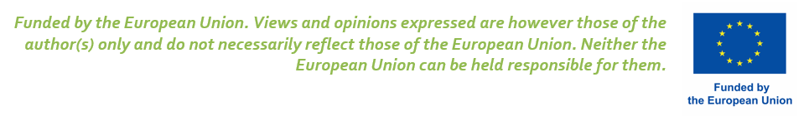
Data-driven applications powered by Data Space: the CLARUS scenarios
//SPEAKER NAME

Slide 2

WHAT IS A DATA SPACE?

Slide 3




Boost Data Sharing
80% Industrial Data is Never Used
Concerns
Solutions
57%
Worry about uncovering valuable data and trade secrets
Trust and Security
59%
Fear of losing control over their data
Data Sovereignity
55%
Feeling inconsistent process and systems as (very) big barrier
Interoperability
Fear that platforms will not reach critical mass
32%
Growing Initiative
https://www.europarl.europa.eu/news/en/headlines/society/20220331STO26411/boosting-data-sharing-in-the-eu-what-are-the-benefits
© PwC-Study on «Industrial Data Space»

Slide 4
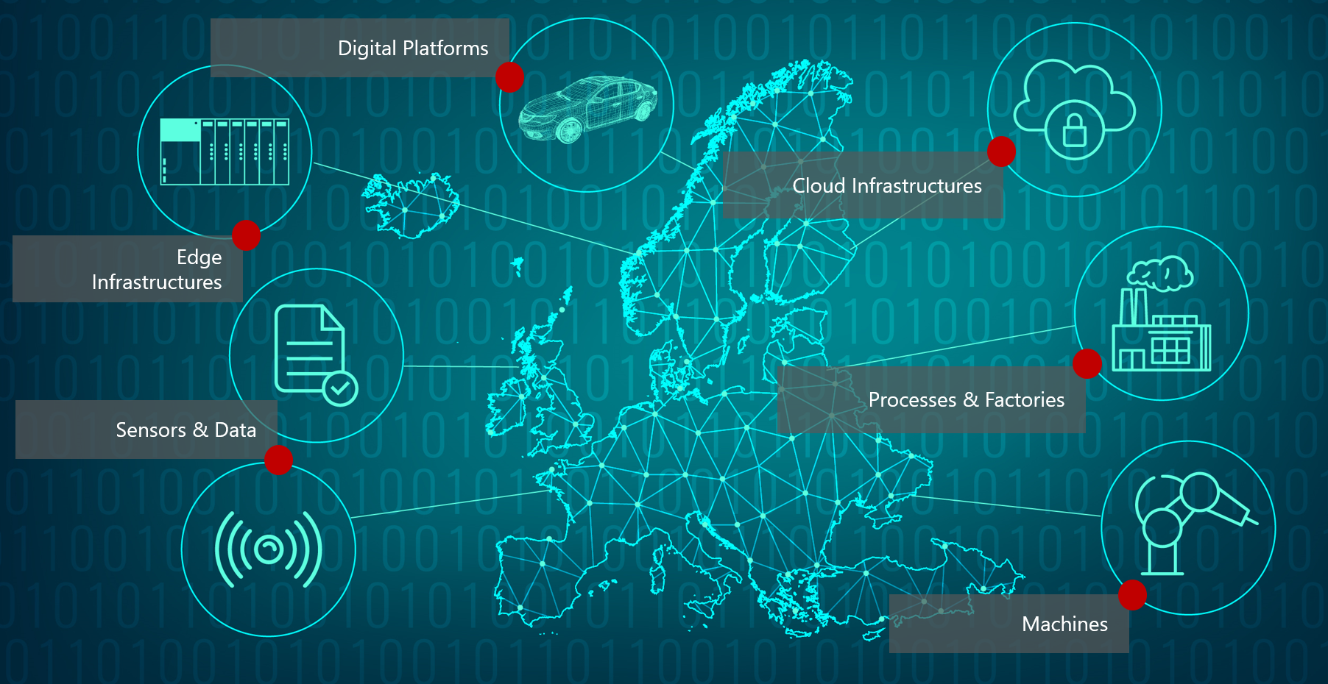
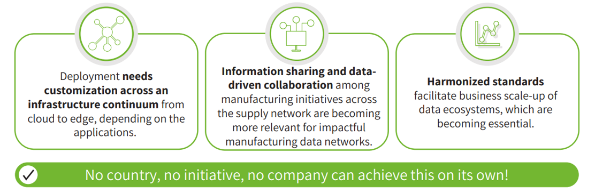
Challenges in global manufacturing
data ecosystem

Slide 5
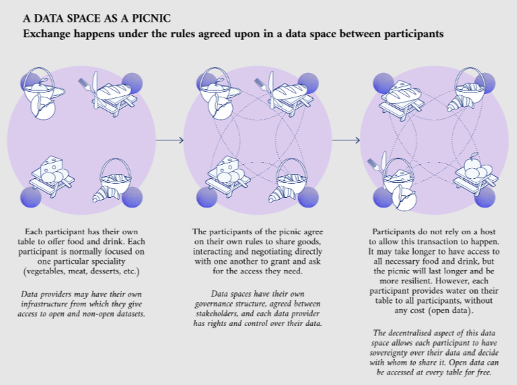
Data sharing through Data Space
The Data Space technology has been developed to guarantee secure and trusted data sharing under the data sovereignty and data governance, pillars.
Multiple participant to a Data Space may provide or consume data, the success of a Data Space (among the others factors) depends on the number of participants.
Typically data shared are suitable for business-driven analysis, are then processed with other technologies such as Artificial Intelligence and/ or Digital Twins.
https://data.europa.eu/en/publications/datastories/when-open-data-meets-data-spaces#:~:text=For%20a%20complementary%20definition%20of,framework%20of%20that%20data%20space%27.&text=Data%20spaces%20exist%20around%20the%20world.

Slide 6
HOW CLARUS?

Slide 7
Data Sharing with ARDO Suppliers
and Consumers
By adopting the Data Space technology at Group level, it would be possible to create a ‘Federated Data Space’, i.e., connected Data Spaces to allow access to each other information (under specific policy/rules).
The individual analysis capabilities (more data = more knowledge = enhanced decision making) are boosted. Data can be leveraged to:
Get a better view on suppliers/customers behaviour,
Better control the supply chain towards sustainability objectives (Data Space for traceability),
Have full visibility of upcoming Data Spaces, there are many ongoing experimentation on relevant topics for ARDO: Manufacturing, Agriculture, Green Deal…
Add additional services like (i) carbon footprint and other relevant environmental parameters optimization cross-country, (ii) process and equipment analysis…

Slide 8
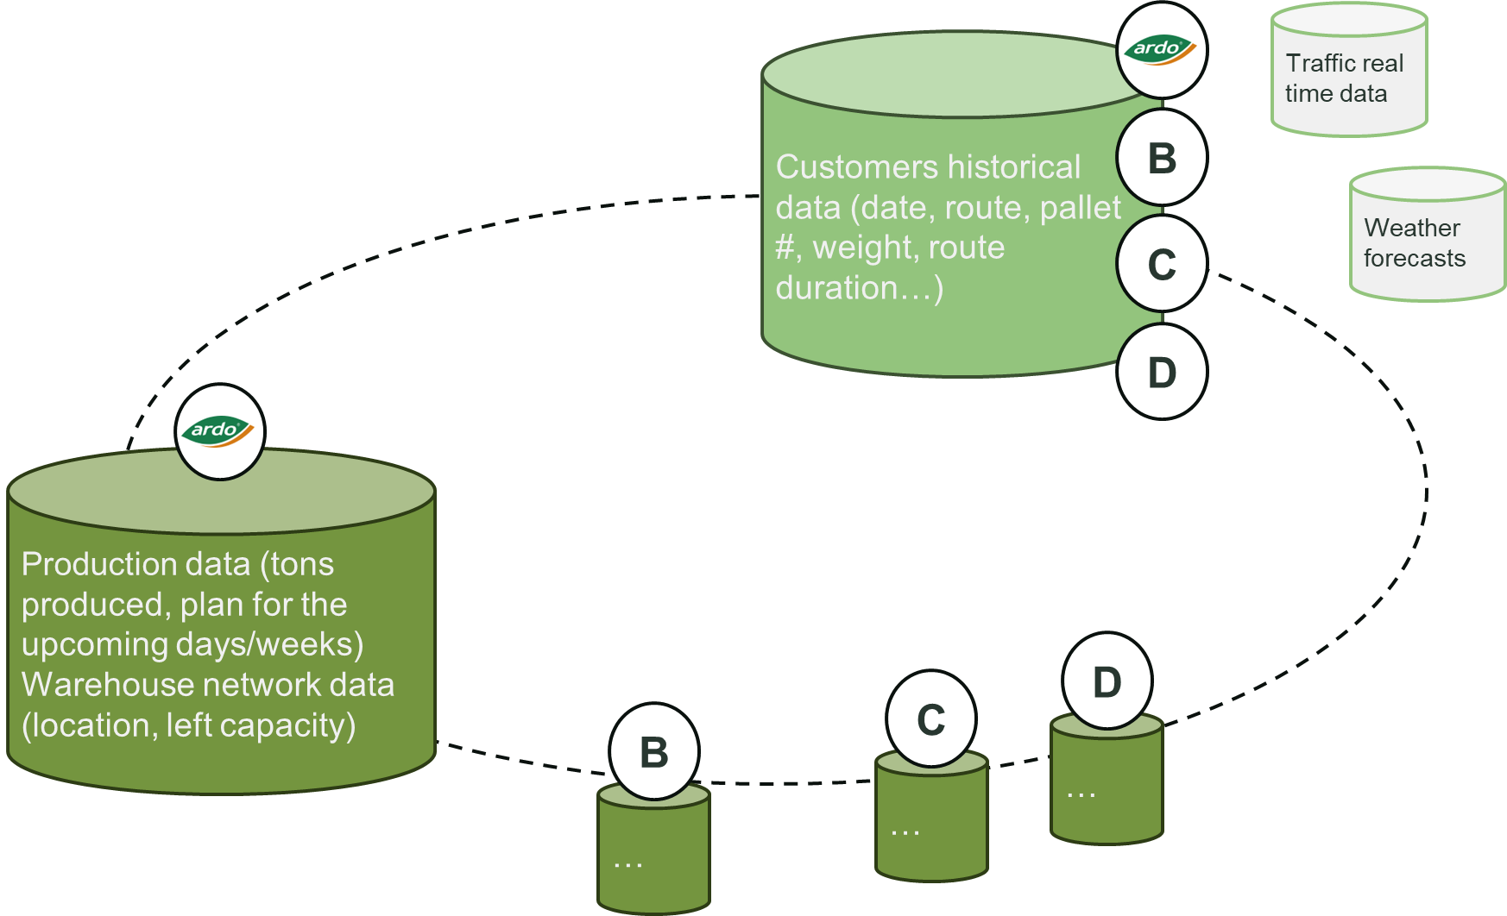
Data Sharing with Logistic Company 1/2
The Logistic Company access via Data Space to its customers production data, analyzes them in conjunction with external datasets (e.g., traffic and weather data) as well as the customers historical data available in Company’s premises and is able to optimize its overall business.
Data Space: automated and autonomous on demand data consultation.
Edge/cloud infrastructure to run AI algorithms.

Slide 9

Data Sharing with Logistic Company 2/2
B
C
LOGISTIC
COMPANY
ARDO
D
Intervention enhanced planning
Equipment enhancement and fewer intervention
Cost reduction (better logistic/operators management)
Process enhanced planning
Taylored services
Discounted intervention for sharing data
Provide and consume data of other stakeholders of the Supply Chain, as the network grows the business opportunities and the benefit grow

Slide 10
OPEN DISCUSSION

