Slide 1

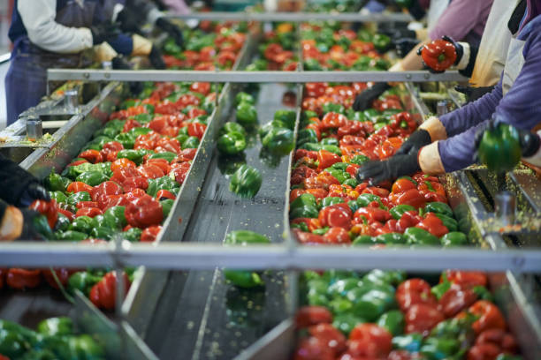




June 4, 2025
Partner Event
Circular Economy in Action: Rethinking Resources for a Greener Future
Promoting AI-Driven Sustainability and Traceability in the Food Industry

Slide 2

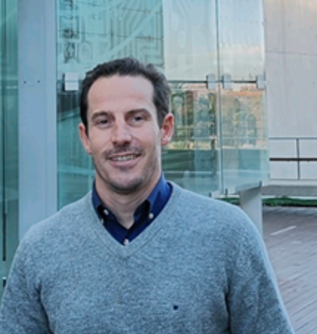


Speaker
Q&A
Ludovica Miele,
Researcher at CIGIP,
Universitat Politècnica de València
lmiele@cigip.upv.es
Francisco Fraile,
Senior Researcher at CIGIP, Universitat Politècnica de València
ffraile@cigip.upv.es
This project has received funding from the European Union's Horizon Europe Research and Innovation Programme
under Grant Agreement N. 101070076
2

Slide 3










CLARUS PROJECT
Optimizing Production and Logistic Resources in the Time-critical Bio Production Industries in Europe
Notes:
2-3 min for project introduction

Slide 4
Motivation
By 2050, the global population is expected to grow by 2 billion, accompanied by rising life expectancy, urbanization, and increasing income levels.
Increase food demand
Change in consumption patterns
20-50%
30%
8.3%
Water
Global water use is estimated to increase by 20 to 50 percent above current levels by 2050, with the industrial and domestic sectors experiencing the most rapid growth.
Energy
The agrifood sector accounts for approximately 30% of global energy consumption.
Greenhouse gas emissions
Global GHG emissions per capita have seen an 8.3% overall increase between 1990 and 2022, reaching a record high in 2022.

Slide 5
CLARUS project
Due to its high consumption of natural resources, food industry represents one of the main sectors requiring a long-term vision to manage sustainability.
GREEN TRANSITION
+
DIGITAL TRANSITION
The CLARUS project aims to optimize production and logistics resources, addressing sustainability challenges in the food sector by connecting the sustainable paradigm with AI-based applications. The objective is to develop a platform for assessing resource consumption and traceability in food industry processes, with a focus on reducing energy and water consumption and optimizing logistics.

Slide 6




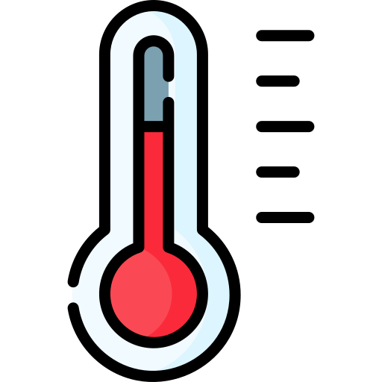
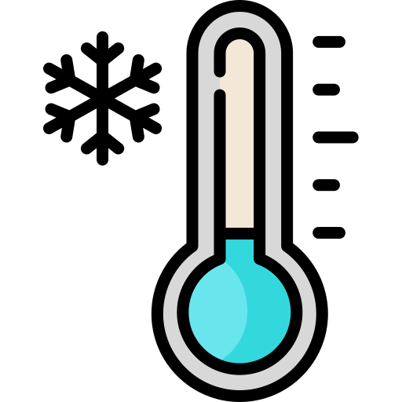





Primary Food Processing Pilot
Vegetables freezing process
Inbound Logistics
Blanching
Freezing
Field
Preparation
Cleaning and
cutting
Washing
85ºC
5ºC
5ºC
-20ºC
Blancher
Freezing Tunnel
Frozen vegetables production, where energy and water consumption can be reduced using AI and data technologies.
Cold Storage
Outbound Logistics
-20ºC
Packaging
Notes:
The main electricity consumer is the processing and storage of vegetables, with refrigeration production being the activity that requires the most consumption. 59% is the production of refrigeration energy for freezing vegetables.
water is consumed in the vegetable washing and preparation, blanching and freezing processes. In the vegetable washing process, water is used to remove impurities mainly soil as these are cultivated products

Slide 7

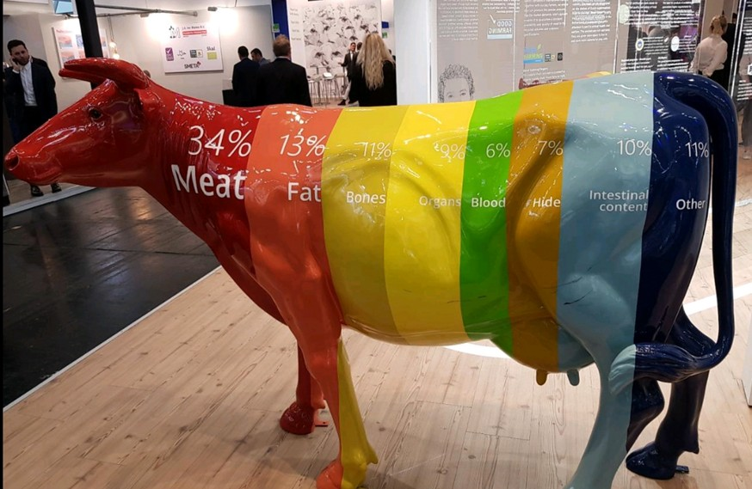

By-Product Pilot
Meat by-product rendering where the aim is to reduce the energy and maintain the quality of the products by optimizing the logistics of the by-products arrival.
Inbound Logistics
Large Slaughterhouse
Processing
Cat1,Cat2,Cat3
Logistics Planning
Cadaver
Collection
Logistics Execution
Sorting
Processing
Cat1,Cat2
Yard Management
Small
Operators
Co2
Cat1,Cat2,Cat3
Co2
Notes:
In the meat industry, only 34% of an animal is used as meat; the rest (fat, bones, organs, blood, hide, etc.) is considered by-product. These by-products can be processed into pet food, pharmaceuticals, fertilizers, bioenergy, cosmetics, and more—turning waste into value and supporting a circular economy.
Category 3 collection is time sensitive and represents around 80% of the incoming material volume. Collecting these raw materials as fresh as possible will enable processing with lower energy consumption and improve final product quality, which leads to lower carbon footprint. Delays in the logistics will downgrade the material quality, which complicates processing,leads into higher resource usage, and yields lower value products.

Slide 8
Key Exploitable Results
8
Green Deal Index
Quantitative methodology and a final index (GDI) to assess the overall impact of an organization on the European Green Deal
Provides a comprehensive sustainability assessment
Data Space
Supports regulatory compliance
AI Toolkit
Enables data-driven optimization
Improves resource efficiency
FAIR data models and Data Platforms tools that are developed and deployed for edge data management, cloud data management, and data harmonization, transformation and sharing
Provides a competitive advantage
AI algorithms and the trained models that are developed, tested, and validated in the project
Notes:
Colores anche nella customer journey

Slide 9

Customer Journey of CLARUS Solution
Manufacturing Company
Initial Evaluation:
Green Deal Index requirements
1
The first step is to understand what the company is already doing to monitor its environmental impact
Indicators selection according to company’s practises and objectives
Data mapping and Infrastructure setup
2
The edge infrastructure is the entry point for data collection and processing in the CLARUS solution. It consists of hardware and software components deployed on the user site including IoT devices and sensors that enable the collection of data required to assess the GDI
Notes:
1. Data Harmonisation and Governance In the initial phase of the CLARUS solution deployment, the Data Space enables companies to ingest, harmonise and semantically structure the data collected at the edge. Thanks to the use of FAIR data models and Industrial Data Platform tools, raw data is transformed into usable, standardised information. At this stage, data governance policies are defined, ensuring that access, usage, and sharing are in line with business objectives and regulatory frameworks.
2. Trusted Data Sharing and Innovation In a second phase, once the system is running, the Data Space becomes a collaborative environment where selected data can be shared with third parties under sovereign and secure conditions, in line with IDSA principles. Populated datasets can be published as open access (for research, benchmarking, or replication), or shared in controlled B2B exchanges, supporting further exploitation, ecosystem collaboration, and cross-sector innovation.

Slide 10
Green Deal Index Assessment
3
The selected indicators are aggregated using the Green Deal Performance Assessment Methodology and the Green Deal Ontology support
4
Data sharing
The CLARUS Data Space acts as a sovereign platform for secure and controlled data exchange among multiple stakeholders. Based on IDSA principles, it enables three-party data sharing with full respect for data ownership and confidentiality. Each participant can define usage policies and access rights, ensuring that data is shared only under agreed conditions and for specific purposes
.
Notes:
Mover edge infrastructure mover antes di GDI assessment
Cambiare il punto di vista del titolo come il customer: collect data (edge infrastructure)
Data space: sharing data
AI models training
Deploy ai models
Requisitos empresa para medir con el GDI
Edge infrustructre (collect data), sensors to m easure
Gdi assessment con real values
Compartir con data scientists, auditors, para dar un valor (data space)
AI models data scientists train ai models con estos datos para mejorar gdi
Mlops : once trained ai models: deploy in plant

Slide 11
AI models for GDI optimization
5
.
These are machine learning algorithms developed and selected to address specific challenges identified in the CLARUS pilots. Typical tasks include anomaly detection, survival analysis, and time series prediction, all aiming to improve resource efficiency. Each algorithm is chosen based on its performance and accuracy in solving the targeted problem within a given use case
Plant deployment
6
The MLOps platform in CLARUS is a core component of the AI Toolkit, designed to support the operational deployment of AI models in industrial environments. MLOps (Machine Learning Operations) refers to a set of practices, tools, and workflows that aim to streamline and automate the end-to-end lifecycle of machine learning models from development and training, to deployment, monitoring, and retraining
Notes:
The edge infrastructure is the entry point for data collection and processing in the CLARUS solution. It consists of hardware and software components deployed on the user site — including IoT devices and sensors — that enable the collection of data required to assess the Green Digital Index (GDI). This infrastructure is the first step toward deploying AI in real-world industrial environments, as it not only captures data from the field but also performs local preprocessing and, when needed, executes AI tasks directly at the edge.
AI models: These are machine learning algorithms developed and selected to address specific industrial challenges identified in the CLARUS pilots. Typical tasks include anomaly detection, survival analysis, and time series prediction, all aiming to improve resource efficiency. Each algorithm was chosen based on its performance and accuracy in solving the targeted problem within a given use case.
The MLOps platform in CLARUS is a core component of the AI Toolkit, designed to support the operational deployment of AI models in industrial environments. MLOps (Machine Learning Operations) refers to a set of practices, tools, and workflows that aim to streamline and automate the end-to-end lifecycle of machine learning models — from development and training, to deployment, monitoring, and retraining.

Slide 12
Based on the Green Deal Performance Assessment methodology, which integrates recognised standards (e.g. ISO 14040, CEPA, n-LCA)
Customisable through company-specific indicator selection
Uses the extensible Green Deal Ontology for semantic interoperability
Applicable to various sectors for sustainability and ESG assessment
Green Deal Index
Transferability of CLARUS solution
Modular, open-source architecture
Compliant with industrial standards (OPC-UA, IEC 62264)
Supports both edge and cloud deployment
Reusable MLOps pipelines
Adaptable AI models for various tasks and sectors
AI Toolkit
Aligned with the vision of Common European Data Spaces for secure and sovereign data exchange
Based on IDSA and Gaia-X principles to ensure trust, interoperability, and control
Uses FAIR data models for consistent and reusable data sharing
CLARUS Dataspace
Notes:
Idsa= The International Data Spaces Association (IDSA)

Slide 13
Takeaways
Data-driven sustainability: CLARUS empowers manufacturing companies to assess and improve their environmental performance through trusted, measurable indicators like the GDI.
AI for circularity: The project deploys tailored AI models to optimise resource use in real industrial settings.
Sovereign and FAIR data sharing: Through the CLARUS Data Space, companies share and manage data securely, respecting ownership and enabling collaboration across the value chain.
Data availability, data quality, and standardized methodologies are key enablers for implementing AI models and making the solution scalable and adaptable across different contexts.

Slide 14


Thank you!
Ludovica Miele, Researcher at CIGIP, Universitat Politècnica de València
lmiele@cigip.upv.es
Francisco Fraile, Senior Researcher at CIGIP, Universitat Politècnica de València
ffraile@cigip.upv.es
CLARUS Project
This project has received funding from the European Union's Horizon Europe Research and Innovation Programme
under Grant Agreement N. 101070076

