Slide 1





REACT Cluster Webinar Series
The Green Deal Index for Environmental Sustainability Assessment for the Food Industry
Cluster Webinar - April 29th, 2025
Roberto Rocca, Researcher at Politecnico di Milano and Technical Coordinator of CLARUS

Slide 2
Agenda
01
02
03
04
01
Introduction and overview of CLARUS project
Sustainability metrics and index developed in CLARUS
03
04
Example of application
Conclusions, Q&A

Slide 3

Manufacturing decarbonization
Sustainability measurement and processes decarbonization
Circular Economy
Digitalization
Servitization
Energy Efficiency
Suppliers' selection basing on sustainability parameters
ICT architectures and Data Spaces
Manufacturing decarbonization
Manufacturing Decarbonization refers to the process by which manufacturing processes and products aim to achieve a low-carbon economy, reducing their carbon dioxide emissions through various measures such as energy efficiency improvements, increased use of renewable energy sources, carbon capture and storage technologies, circular technologies and adoption of digital technologies.

Slide 4

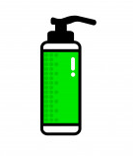

Sustainability data and Data Space
The convergence of Sustainable Manufacturing paradigm and Digital Transformation paradigm under the same umbrella, is pushing manufacturing companies to design Information and Communication Technology (ICT) data-driven industrial architectures for resource consumption assessment and traceability of manufacturing systems.
The focal point is therefore the “Environmental Sustainability Data”, intended as the source of information strictly related to sustainability, whose correct collection, analysis and tracing can lead to enormous benefits for the natural resources management of manufacturing systems.
Green and Digital Transition of Manufacturing Industry

Slide 5
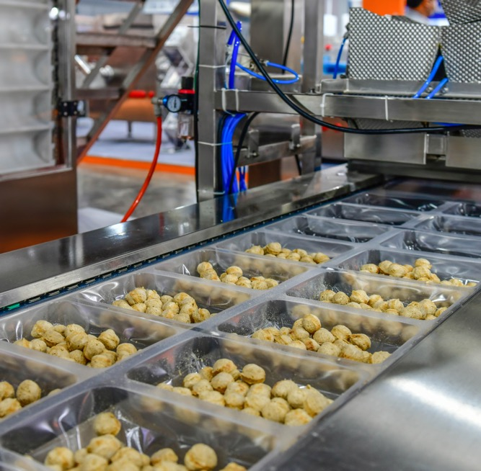
Context of CLARUS project
The Food Sector

Slide 6
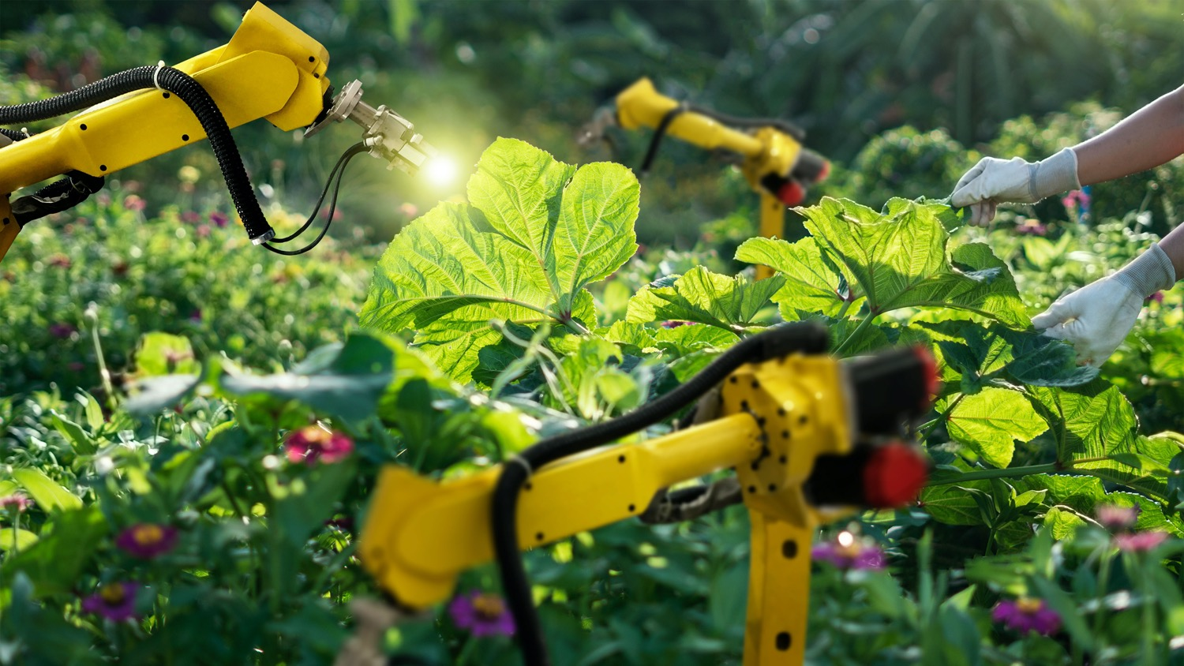
Notes:
The growth of the world’s human population, the advent of resource shortages and environmental difficulties are forcing industrial sectors to face sustainability issues more than ever.
Due to its high consumption of natural resources, food industry represents one of the main sectors requiring a long-term vision to manage sustainability.
There is the need to guide the sector toward a Green Transition by improving the environmental and social sustainability of its activities, products and processes, leveraging also on Digital Transition.

Slide 7
Clarus project
Grant agreement ID: 101070076
Start date: 1 September 2022
End date: 31 August 2025
Total cost: € 3 423 248,75
EU contribution: € 2 999 105,75
“Optimizing Production and Logistic Resources
in the Time-critical
Bio Production Industries
in Europe”
The project was submitted under the call HE-CL4-DIGITAL-EMERGING-01-09: AI, Data and Robotics for the Green Deal and targets the non-robotic outcome.

Slide 8
Consortium

Slide 9

Objectives
The CLARUS project aims to connect the Sustainable Paradigm in the food industry and AI-based applications, with the goal of developing a platform with high communications and processing capabilities, as well as the use of standardized open protocols and data models that will allow resource consumption assessment and traceability for food industry processes.
Correct collection, analysis and tracing of “Sustainability Data” of food production and consumption, can lead to enormous benefits for the natural resources management within food manufacturing systems and food supply chains.
Digital Transformation of food companies represents an enabler of Sustainability Transformation thanks to the benefits smart technologies can offer in terms of data management and elaboration.
Benefits
Two pilots for validating the CLARUS solution:

Slide 10
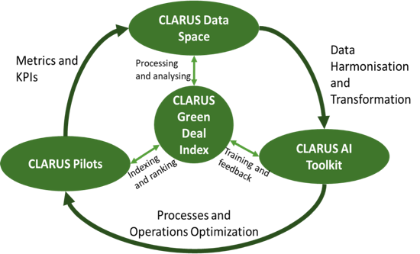
Approach
The CLARUS Green Deal Index processes and analyses the data in the CLARUS Data SPACE.
The processing and analysis is done by the CLARUS AI Toolkit.
The CLARUS GDI interacts with the CLARUS Pilots to provide the indexing and ranking feature to drive the improvements towards Green Deal friendlier process and operations.
3 Tangible Expected Outcomes
Notes:
CLARUS is strictly connected with the European Green Deal program in order to develop and define a unique quantitative and standard methodology to support the elaboration of a green-friendly food industry structure and culture, that can generate business in a sustainable way and with a much smaller impact on the environment.
CLARUS ambitions try not only to contribute to resource and logistic optimization methods with the two pilots' solutions but aims to generate a more general contribution with the creation of a Green Deal Index (GDI).

Slide 11




Green Deal Index
11
AI Tool kit
Indexing and ranking
Data Space
Training and feedback
Processing and analysing
Pilots
Metrics and KPIs
Process and
operations optimization
Data harmonization and transformation
Semantics and computation formalization
Data contextualization
Physical connection
Logical connection
Green Deal Ontology

Slide 12
Green Deal Index (GDI)
The Green Deal Index (GDI) is a comprehensive sustainability Key Performance Indicator developed to measure the manufacturing companies’ sustainability performance and alignment with the EU Green Deal objectives. It assesses environmental, social, and economic factors related to sustainability, carbon neutrality, and circular economy practices.
Notes:
Why is it Important?
Helps businesses and policymakers track sustainability progress.
Provides a benchmarking tool to compare companies/sectors.
Supports decision-making for green investments and policy design.

Slide 13
Semantics to ease the data identification and KPI calculation of GDPA
Green Deal Performance Assessment (GDPA) methodology
Green Deal Ontology
Indicators selection
Scores identification and aggregation method selection
Indicators aggregation (GDI)
GDI ARDO
GDI HONKA
FINAL OBJECTIVE GDI
AS-IS (before CLARUS)
? Impact of AI Toolkit ?
TO-BE (after CLARUS)
Notes:
Since GDI is being computed within the CLARUS project, but it's not technically linked to the Data Space and AI Models, we need to propose a coherent architecture that integrates all elements logically.

Slide 14
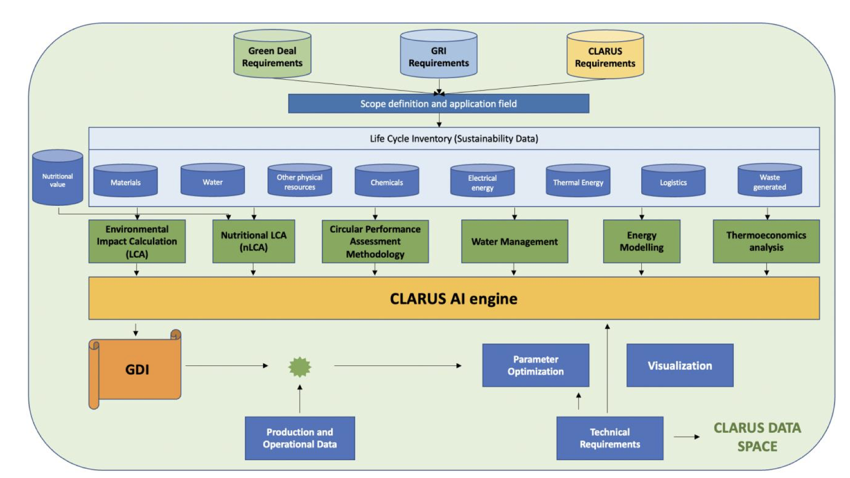
Green Deal Performance Assessment methodology
GDPA Methodology General Scheme

Slide 15
Green Deal Ontology concept
A Green Deal Ontology (GDO) is developed, that represents a set of representational primitives with which to model the environmental sustainability domain of knowledge created by the Green Deal Performance Assessment (GDPA) methodology, developed in WP1.
The representational primitives will be classes, properties, and relationships necessary and useful to gather environmental sustainability data and allow the calculation of the Green Deal Index (GDI).
The new Green Deal Ontology will allow for modeling knowledge about environmental sustainability data and performances in the food engineering domain.
By providing context and purpose to data, the ontology allows for enhancement of knowledge interpretability and reusability.

Slide 16
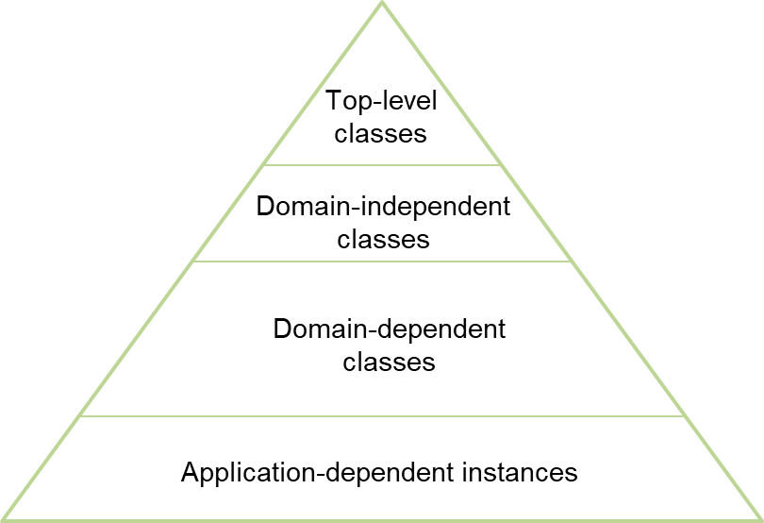
Green Deal Ontology concept
Purpose of the Ontology
Semantically formalizes KPI computation for the Green Deal Index (GDI)
Links KPIs to food processes, equipment, and data sources
Enables context-aware sustainability analysis
Knowledge Reuse for Similar Processes
Companies with similar processes to pilot cases can:
Discover relevant sustainability KPIs
Understand where input data is collected (e.g., equipment, process step)
Get insight into how processes impact sustainability
Methodological Guide for New Scenarios
For companies with different processes:
Acts as a template to formalize new KPIs
Offers a structured approach to sustainability modeling
Promotes interoperability and comparability

Slide 17
The Applied Scenario
Analytical Hierarchy Process (AHP) is considered a solid alternative for structuring sustainability assessments as it allows: expert judgment, qualitative criteria weighting, and multi-criteria decision-making, making it a practical method for evaluating sustainability performance in CLARUS.
Identification of Indicators (based on Green Deal Performance Assessment methodology and Green Deal Ontology)
Selection of relevant indicators for each pilot
Grouping indicators (environmental, enterprise, process system, process segment, equipment)
Gathering information for each relevant indicator (target values, current values)
Normalization (Distance to Target)
Weighting Indicators (Analytic Hierarchical Process (AHP))
Calculate sub-indices indicators based on how the indicators were previously grouped
Combination of the sub-indices to form the Green Deal Index
Environment
Enterprise
Process
Process segment
Equipment
Notes:
By breaking it down into environmental, enterprise, process, and equipment levels, we ensured a multi-layered assessment of sustainability performance, leveraging expert input ensures the AHP reflects real-world priorities and industry insights rather than just theoretical assumptions.

Slide 18
Ardo Scenario 1 KPIs
Hierarchy levels
KPI ID | Target
KPI1.1 | Decrease equivalent CO2 emissions
KPI1.2 | Decrease the global warming impact of the freezing installation (TEWI)
KPI1.3 | Increase the energy efficiency of the enterprise (electric energy used per ton of product)
KPI1.4 | Improve the performance of the freezing installation
KPI1.5 | Increase the energy efficiency of the production lines
KPI1.6 | Increase the performance of freezing installation equipment
KPI1.7 | Increase the availability of freezing installation equipment
Environment
Enterprise
Process
Process segment
Equipment

Slide 19
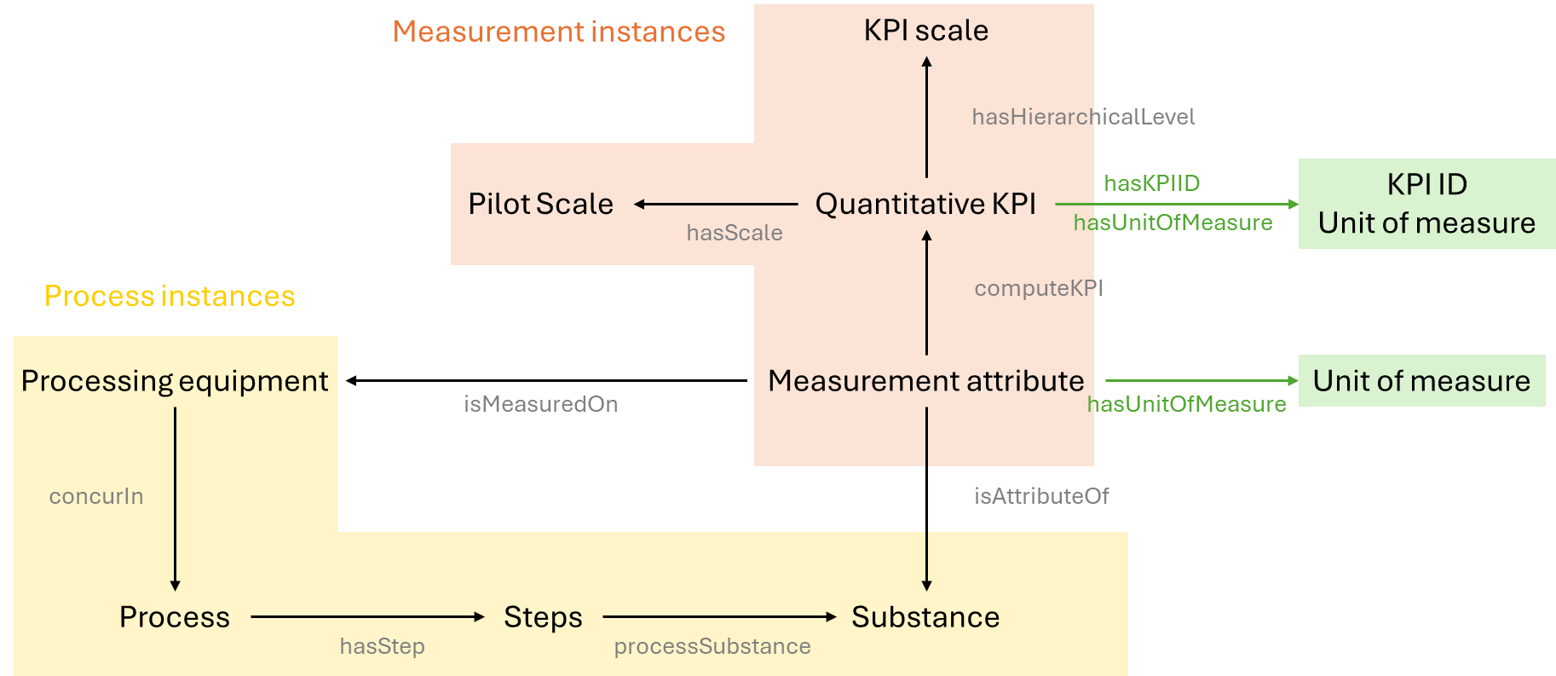
Ardo: schema of the green deal ontology
Classes modeled in the GDO for Ardo pilot – process and measurement levels - and relations among instances within each class

Slide 20
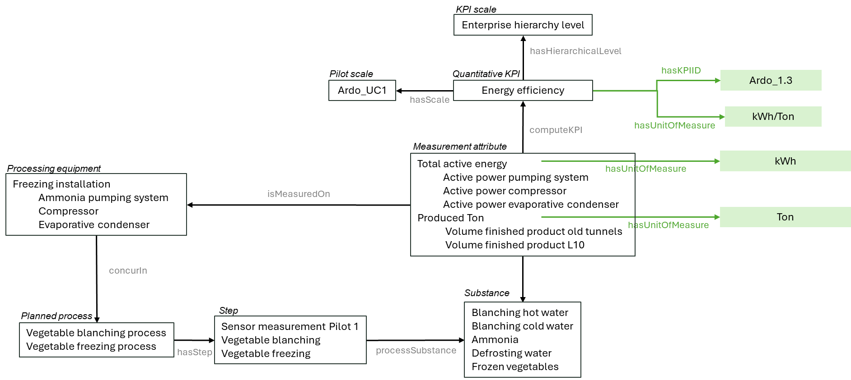
KPI example: Ardo energy efficiency

Slide 21

Example of GDI calculation
Weighted sum
Indicator | Value | Weight | Level | Value | Weight | GDI
CO₂ equivalent emissions (KPI 1.1) | 94.9% | 0.77 | Environment | 87.6% | 0.38 | 86.9%
Total Equivalent Warming Impact (TEWI) (KPI 1.2) | 63.7% | 0.23
Plant energy efficiency (KPI 1.3) | 94.3% | 0.67 | Enterprise | 91.7% | 0.24
Plant water efficiency (KPI 2.1) | 86.7% | 0.33
Coefficient of Performance (COP) (KPI 1.4) | 75.0% | 1 | Process | 75.0% | 0.21
Freezing installation energy efficiency (KPI 1.5) | 90.0% | 0.75 | Process Segment | 90.8% | 0.11
Water pumps energy efficiency (KPI 2.2) | 93.3% | 0.25
Compressor thermal energy efficiency (KPI 1.6) | 97.8% | 0.62 | Equipment | 97.9% | 0.06
Freezing installation availability (KPI 1.7) | 97.9% | 0.26
Water pumps availability (KPI 2.3) | 97.9% | 0.12

Slide 22
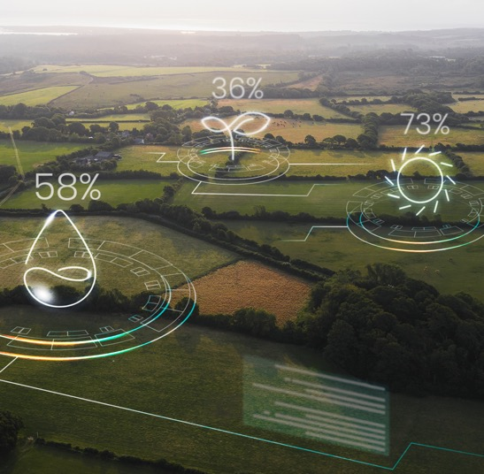
Results interpretation
The results are presented using the Traffic Light System criteria to visually identify the performance of the indicators, hierarchy levels and GDI.
POOR
FAIR
GREEN
Value ≤ 60
60 > Value ≤ 90
Value > 90
The ranges could be redefined if necessary

Slide 23
Conclusions
Correct collection, analysis and tracing of “Sustainability Data” of food production and consumption, can lead to enormous benefits for the natural resources management within food manufacturing systems and food supply chains.
Digital Transformation of food companies represents an enabler of Sustainability Transformation thanks to the benefits smart technologies can offer in terms of data management and elaboration.
Benefits
CLARUS Green Deal Index: methods, tools and data used to calculate the Green Deal Index (GDI). This GDI would be applied to different dimensional scales (e.g., companies, cities, countries, or processes) allowing to have a complete measure of how compliant with the Green Deal they are.
CLARUS Data Space: FAIR data models and Industrial Data Platforms tools that are developed and deployed for edge data management, cloud data management, and data harmonization, transformation and sharing.
CLARUS AI Toolkit: AI algorithms and the trained models that are developed, tested, and validated in the project.
3 Tangible Expected Outcomes

Slide 24
Thank You
Do you have any questions?
Roberto Rocca, Politecnico di Milano – roberto.rocca@polimi.it

